Slide 1
Task - 06 : Completed paper
CNN Based Federated Learning for Breast Cancer Diagnosis using Ultrasound Images
Group 41
Fatema Tuj Jahura (23366007)
Ripa Sarker(23366009)
Raisa Hasan Bushra(23366014)
Tasnim Fuyara Chhoan(23366035)
Course Instructor: Annajiat Alim Rasel
Mehnaz Ara Faizul (ST)
Humaion Kabir Mehedi (RA)

Slide 2
Table of content
Introduction
Literature Survey
Collected Data
Methodology
Result Analysis
Limitation
Future Scope
Conclusion
Reference

Slide 3
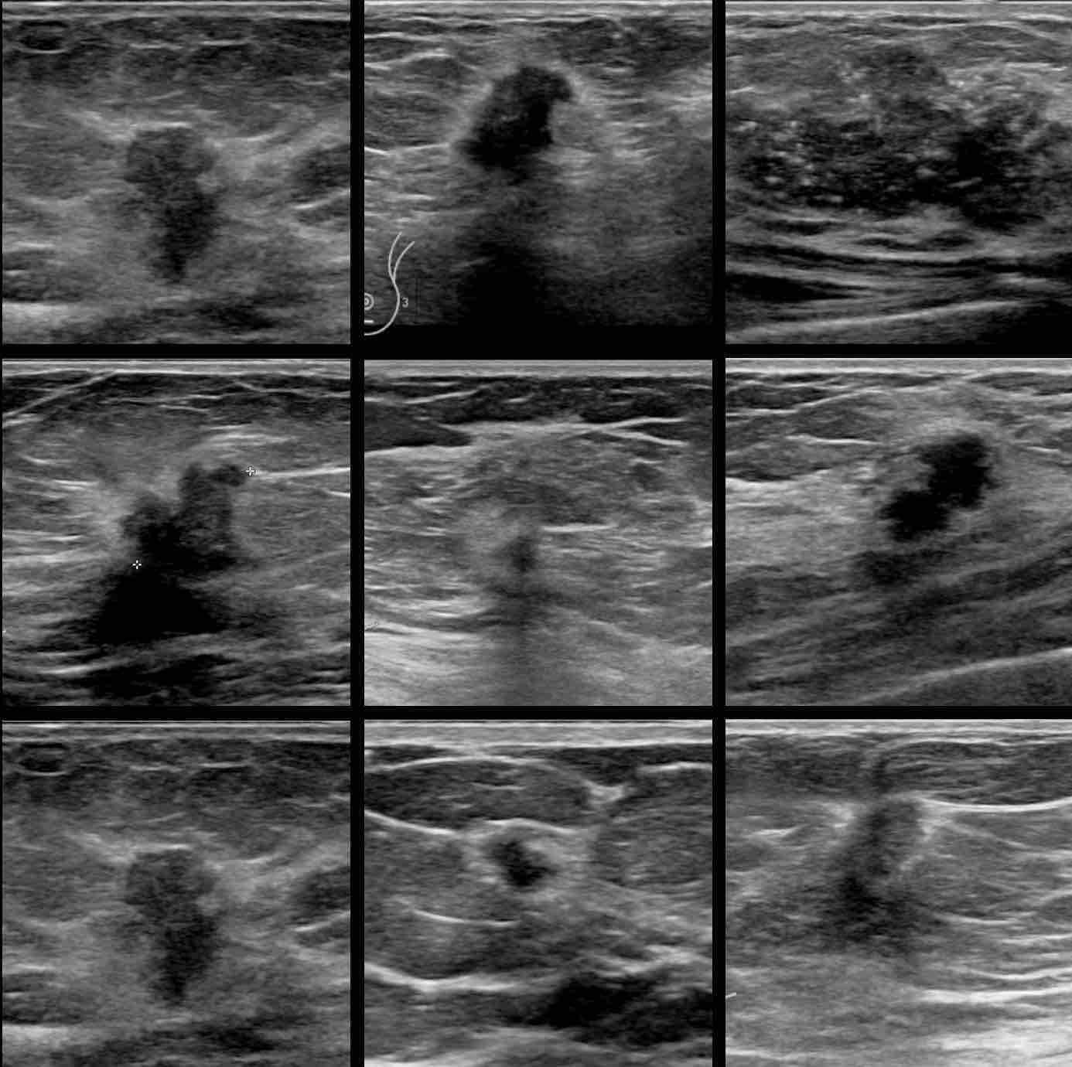
Introduction
Problem Statement:
Illustration on breast cancer
Ways of breast cancer detection
Risk of human error in manual diagnosis
Used Tools:
Federated Learning (FL)
Convolutional Neural Networks (CNN)
Integration of CNN-based federated learning for breast cancer diagnosis

Slide 4
Literature Survey
Developed Federated Learning infrastructure with Transfer Learning.
Collaborative Federated Learning for COVID-19 Screening.
Systematic Literature Review on FL in Medical Image Analysis.
Transfer Learning on Ultrasound Images for Breast Cancer Classification.
CNN-Based Breast Cancer Diagnosis with Large Dataset.

Slide 5
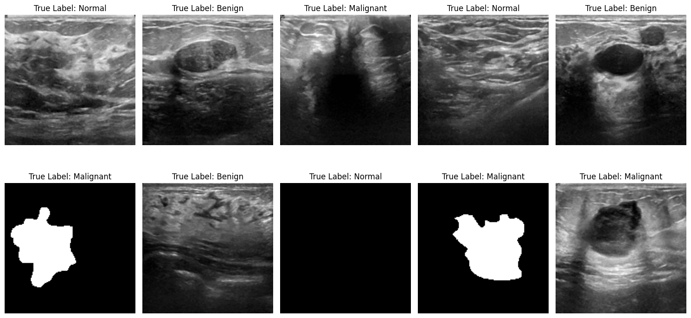
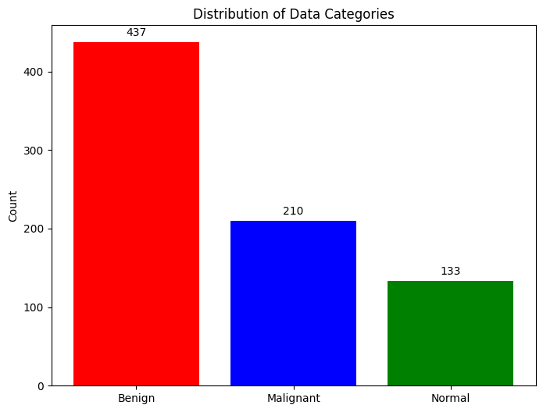
Collected Data
Breast Ultrasound Dataset Overview
Source: Kaggle
Year of Collection: 2018(updated 2020)
Patients: 600 females
Total Images: 1578 (PNG format)
Image Size: 500*500 pixels
Categories:
Normal (266 files)
Benign (891 files)
Malignant (421 files)

Slide 6
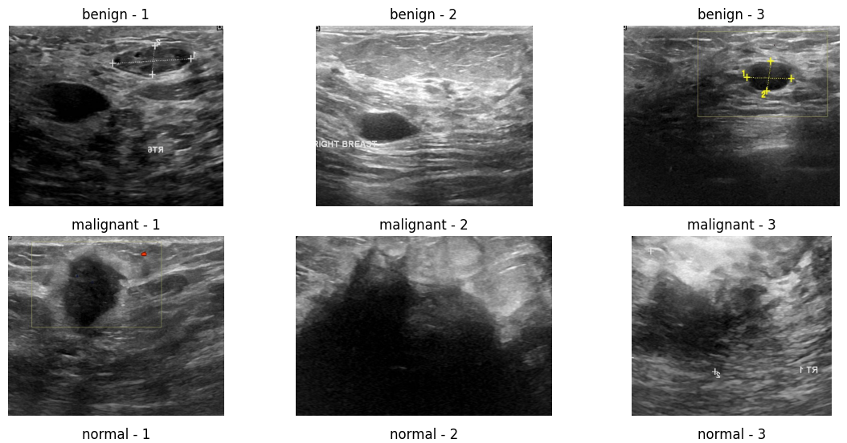
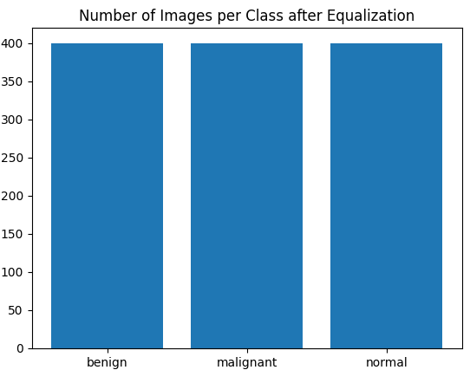
Collected Data (Continued)
Dataset contains masked image along with ultrasound images
Dataset is imbalanced
Remove making image from the dataset.
Apply Augmentation in the dataset pre-processing steps for balancing the imbalanced Dataset

Slide 7
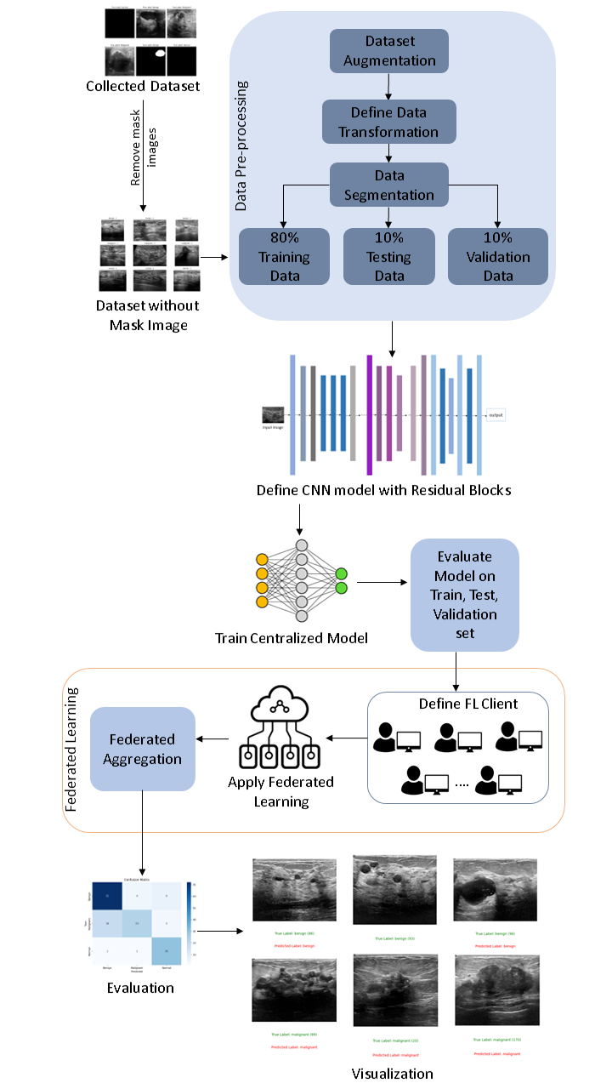
Methodology
Collect Dataset
Data Pre-processing
Data Segmentation
Train 80%
Test 10%
Validation 10%
Define CNN Model with Residual Block
Centralized Training
Federated Learning
Evaluation
Visualization

Slide 8
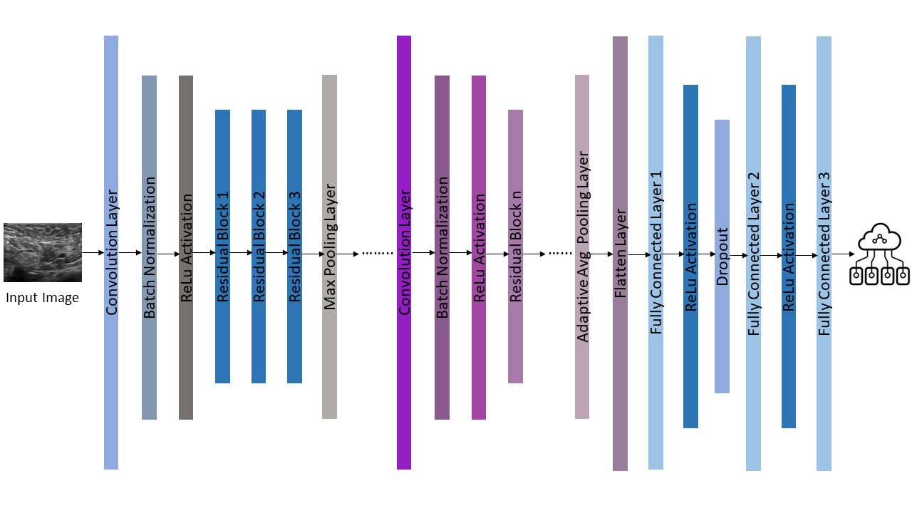
Methodology
CNN with Residual Block Model Architecture

Slide 9
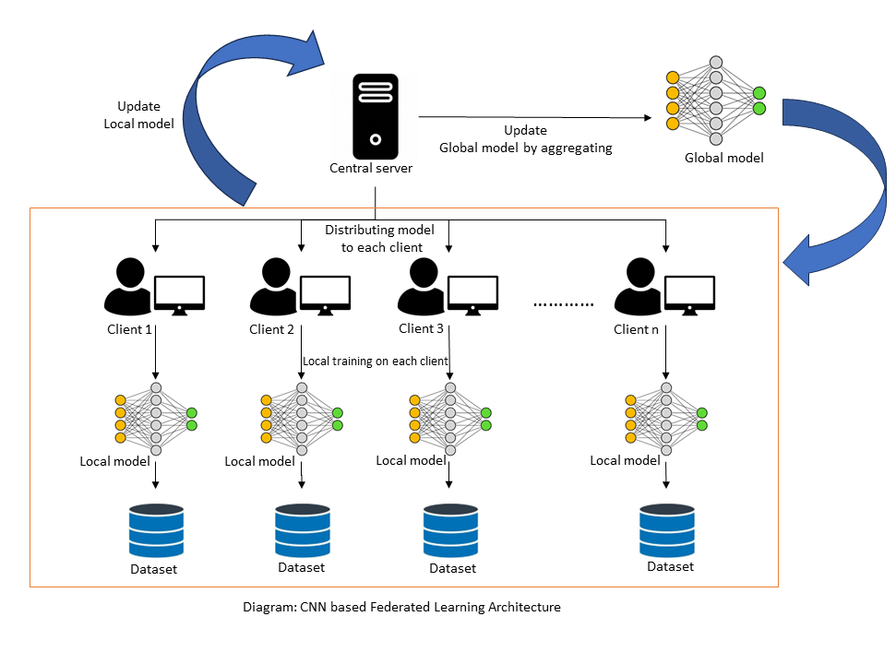
Methodology
CNN Based Federated
Learning Architecture
Centralized Training
Model Distribution
Local Training
Model Update
Global Model Update
Iterative Process

Slide 10
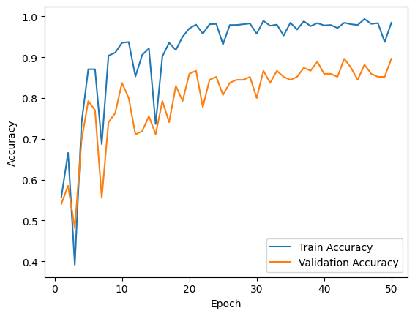
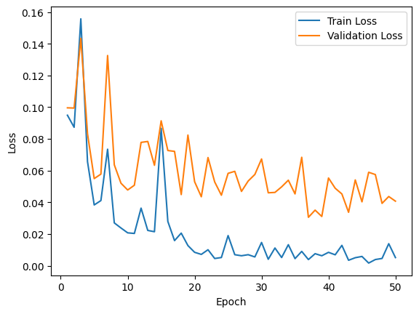
Result Analysis
Centralized Training Performance: The custom CNN, trained centrally, achieves an impressive accuracy of 98.43% and tested with accuracy 93.33% over 50 epochs, demonstrating robust learning and minimal loss reduction with 0.0052 for training and 0.0500 for testing.

Slide 11
Result Analysis
Federated Learning Performance: Federated learning yields outstanding results, with a final training accuracy of 98.42% and minimal loss (0.0052), showcasing adaptability to decentralized datasets.
Federated Test Set Evaluation: The federated model maintains high accuracy (93.33%) and low loss (0.0499) in the test set, highlighting its enhanced performance compared to centralized training.

Slide 12
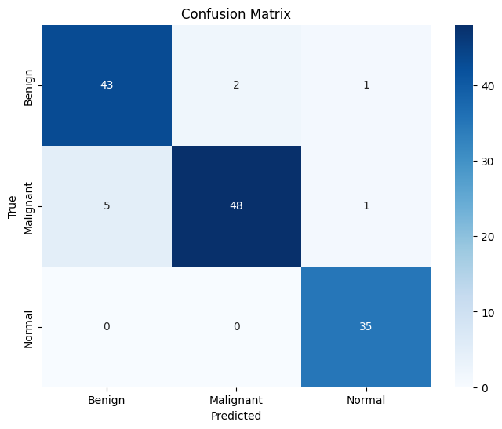
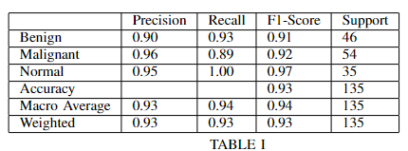
Result Analysis
Classification Report and Confusion Matrix Analysis: The model excels in classifying benign, malignant, and normal cases, as evidenced by high precision, recall, and F1-score metrics. The confusion matrix underscores its discriminative abilities for practical medical applications.

Slide 13
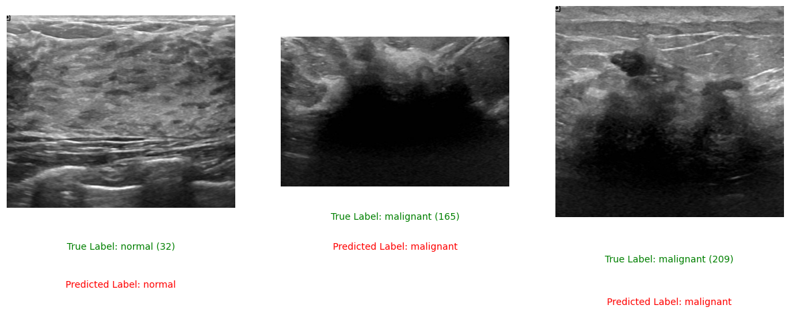
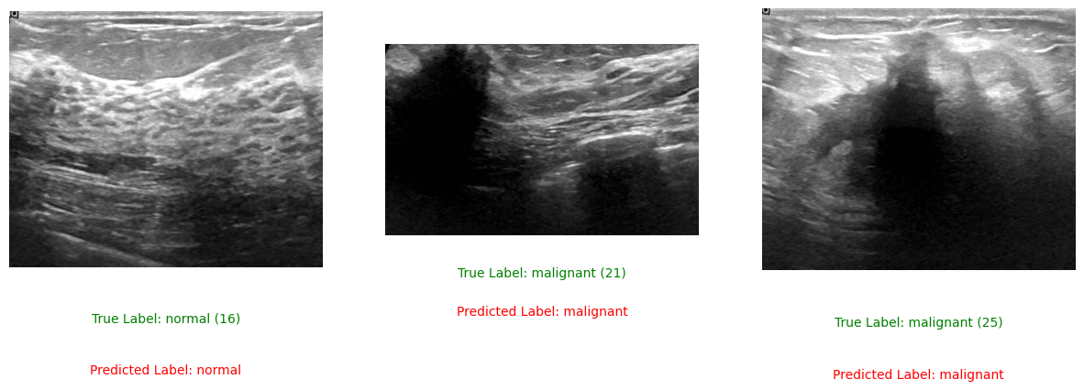
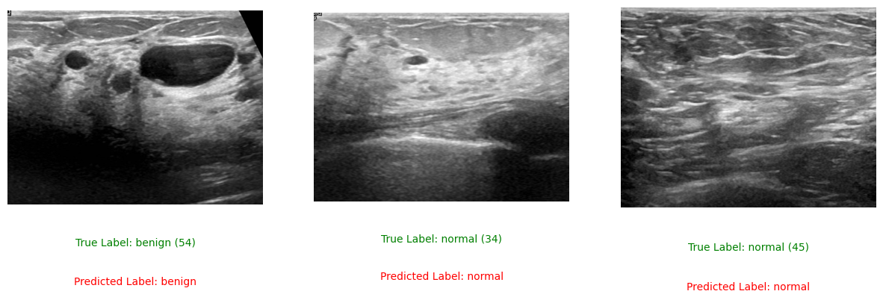
Result Analysis

Slide 14
Limitation
Dataset complexity
Class imbalance: unequal distribution of samples across different classes.
Higher resolutions capture more intricate patterns but require more computational resources.
Presence of multiple classes (3 class)
Lack of Computational resource
Need to add more complex network (working on this)

Slide 15
Future Scope
Can make more complex convolutional neural network (CNN)
Increase Network Depth and Width
Incorporate Different COnvolutional Architecture
Spatial Pyramid Pooling (SPP) Layer
(We are working on improving)
Replace central server with scalability
Can use this model beyond breast cancer dataset in other healthcare sectors for medical image analysis, clinical data analysis. Moreover besides healthcare sector, we can use this model in finance to fraud detection, credit scoring, in smart cities for traffic management, environment monitoring, for manufacturing like quality control, predictive maintenance , in telecommunication for network optimization, customer churn prediction, in agriculture for crop disease prediction, weather forecasting and so on.

Slide 16
Conclusion
The integration of CNN and Federated Learning (FL) for breast cancer detection using ultrasound images offers a promising solution to the challenges of centralized medical data. Leveraging the strengths of CNNs for intricate feature analysis and FL for collaborative learning from decentralized datasets, this approach aims to enhance diagnostic accuracy. Through meticulous dataset handling, model training, and result analysis, the combined model demonstrates potential for improved breast cancer diagnosis. The emphasis on large-scale deployment, integration with clinical workflows, and multi-model fusion underscores its practical applicability and holistic diagnostic capabilities.

Slide 17
References
[1] Katar, Oğuzhan Yildirim, Özal. (2023). Breast Cancer Segmentation from Ultrasound Images Using ResNext-based U-Net Model. Bitlis Eren Üniversitesi Fen Bilimleri Dergisi. 12. 10.17798/bitlisfen.1331310.
[2] KhoKhar, F. A., Shah, J. H., Khan, M. A., Sharif, M., Tariq, U., Kadry, S. (2022). A review on federated learning towards image processing. Computers and Electrical Engineering, 99, 107818.
[3] Hossain, M. A., Sajib, M. S. A. (2019). Classification of image using convolutional neural network (CNN). Global Journal of Computer Science and Technology, 19(2).
[4]Y. N. Tan, V. P. Tinh, P. D. Lam, N. H. Nam, T. A. Khoa, "A Transfer Learning Approach to Breast Cancer Classification in a Federated Learning Framework," IEEE Access, Volume 11: 2023, Electronic ISSN: 2169-3536, INSPEC Accession Number: 22840396, Page(s): 27462 - 27476.
[5]I. Feki, S. Ammar, Y. Kessentini, and K. Muhammad, "Federated learning for COVID-19 screening from Chest X-ray images," Applied Soft Computing, 2021 Jul, 106: 107330.
[6] M. F. Sohan, and A. Basalamah, "A Systematic Review on Federated Learning in Medical Image Analysis," IEEE Access, 2023, Volume: 11, Page(s): 28628 - 28644.
[7]Masud, Mehedi Rashed, Amr Hossain, M. Shamim. (2022). Convolutional neural network-based models for diagnosis of breast cancer. Neural Computing and Applications. 34. 1-12. 10.1007/s00521-020-05394-5.
[8]Alanazi, Saad Kamruzzaman, MM Sarker, Md Nazirul Islam Alruwaili, Madallah Alhwaiti, Yousef Alshammari, Nasser Siddiqi, Muhammad. (2021). Boosting Breast Cancer Detection Using Convolutional Neural Network. Journal of Healthcare Engineering. 2021. 1-11. 10.1155/2021/5528622.

Slide 18
Thank You!

